Slide 1

SOFTWARES
STUDENT NAME : DINAYA MADHURYA
STUDENT NUMBER : CL/OTHMFL3/11/56

Slide 2

A software, also known as computer software or simply "program," refers to a set of instructions that tell a computer how to perform specific tasks or operations. It is a collection of code written in a programming language that is executed by a computer's central processing unit (CPU). Software can take various forms and serve different purposes, ranging from simple applications to complex operating systems.
There are two main types of Softwares :
System Software
Application Software

Slide 3

APPLICATION SOFTWARE
SYSTEM SOFTWARE
This software is designed to perform specific tasks or provide specific functionality for end-users. Applications can include word processors, web browsers, games, photo editors, and more. Application software is built on top of the system software and relies on its services and capabilities.
This type of software is responsible for managing the hardware components of a computer system and providing a platform for running application software. Examples include operating systems (like Windows, macOS, and Linux) and utility software (like antivirus programs and device drivers).

Slide 4









TYPES OF SOFTWARE

Slide 5
SOFTWARE
SYSTEM SOFTWARE
APPLICATION SOFTWARE
OPERATING WINDOW DEVICE
ANTI-VIRUS SOFTWARE DEVICE
PACKAGES
OFFICE PACKAGES
GENERAL PURPOSE SOFTWARE
LANGUAGE PASCAL
C + + PYTHON JAVA
SPECIAL PURPOSE SOFTWARES

Slide 6

GENERAL PURPOSE SOFTWARE
General-purpose software is flexible and can be adapted to different tasks, making it widely applicable in diverse settings. Users can leverage these applications for a variety of purposes, making them an essential part of computing in both personal and professional environments. They are designed to perform a wide range of tasks and functions rather than being specialized for a specific application or industry
It is relatively cheap
It is easily available from most
computer shops

Slide 7
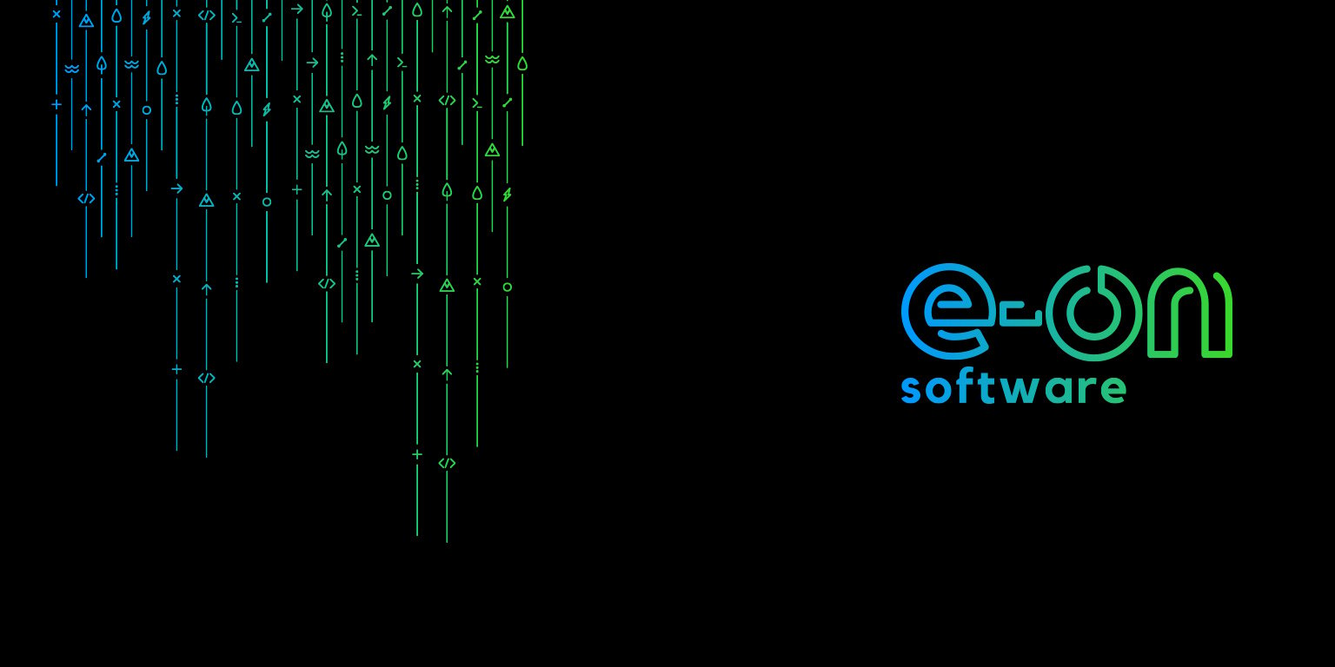
SPECIAL PURPOSE SOFTWARE
Special-purpose software, also known as custom software or bespoke software, is designed to perform a specific set of tasks or functions for a particular user or organization. Special-purpose software is tailored to meet the unique requirements of a specific user, industry, or business process. This type of software is often created to provide a targeted solution that cannot be adequately addressed by off-the-shelf or generic software.
Examples of special-purpose software:
Computer-Aided Design (CAD) Software
Healthcare Information Systems:
Automated Trading Systems:

Slide 8

SOFTWARE LICENSING
Software licensing refers to the legal agreement between the owner of a software product and the end-user, defining the terms and conditions under which the software can be used.
Types of Software Licenses:
Proprietary or Commercial Licenses: Users pay for the right to use the software
and are typically bound by specific terms and conditions.
Free and Open Source Software (FOSS) Licenses: Users are granted certain freedoms, such as the ability to view, modify, and distribute the source code. Common licenses include the GNU General Public License (GPL), Apache License, and MIT License.

Slide 9

Proprietary software
Proprietary software, also known as closed-source software or commercial software, refers to software that is owned by a specific company or individual (the proprietor or owner).
While proprietary software provides certain benefits, such as professional support and often a polished user experience, users must adhere to the terms specified in the license agreement.

Slide 10

STUDENT NAME : DINAYA MADHURYA
STUDENT NUMBER : CL/OTHMFL3/11/56

